Slide 1

Giang hồ Part-time NCC
3rd CodeWar
COCC Team

Slide 2




Slide 3




Slide 4
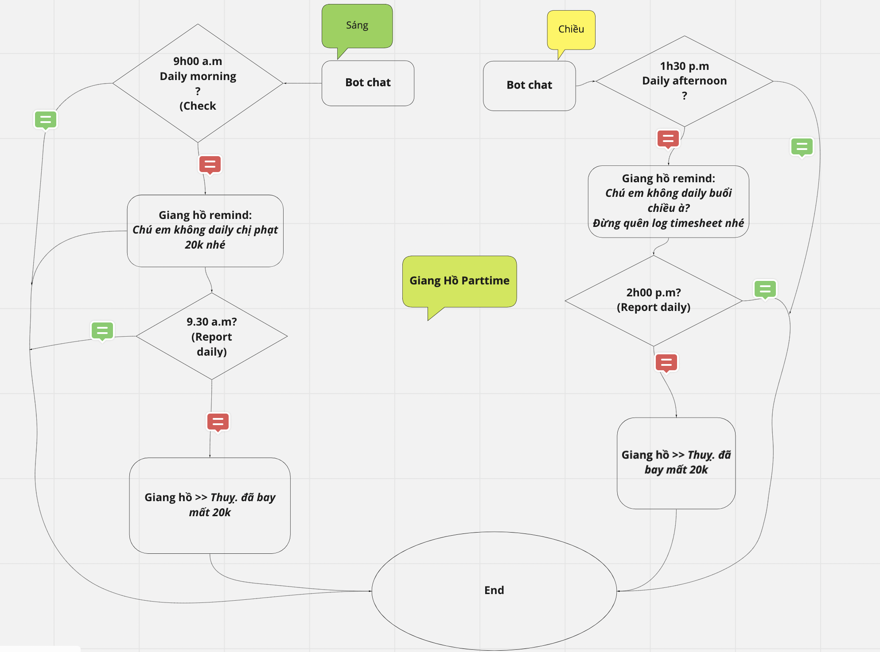
Solution

Slide 5
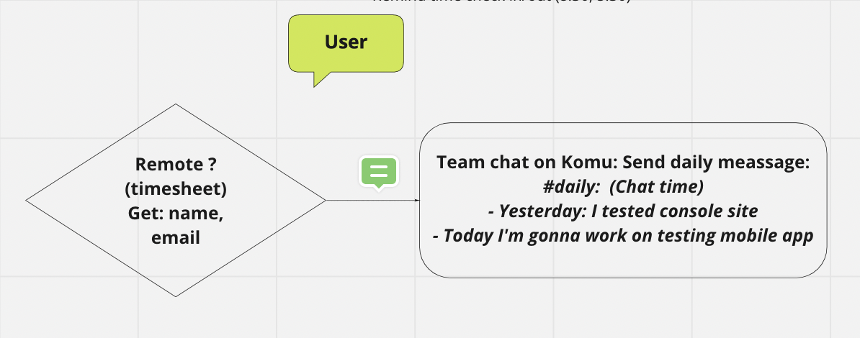
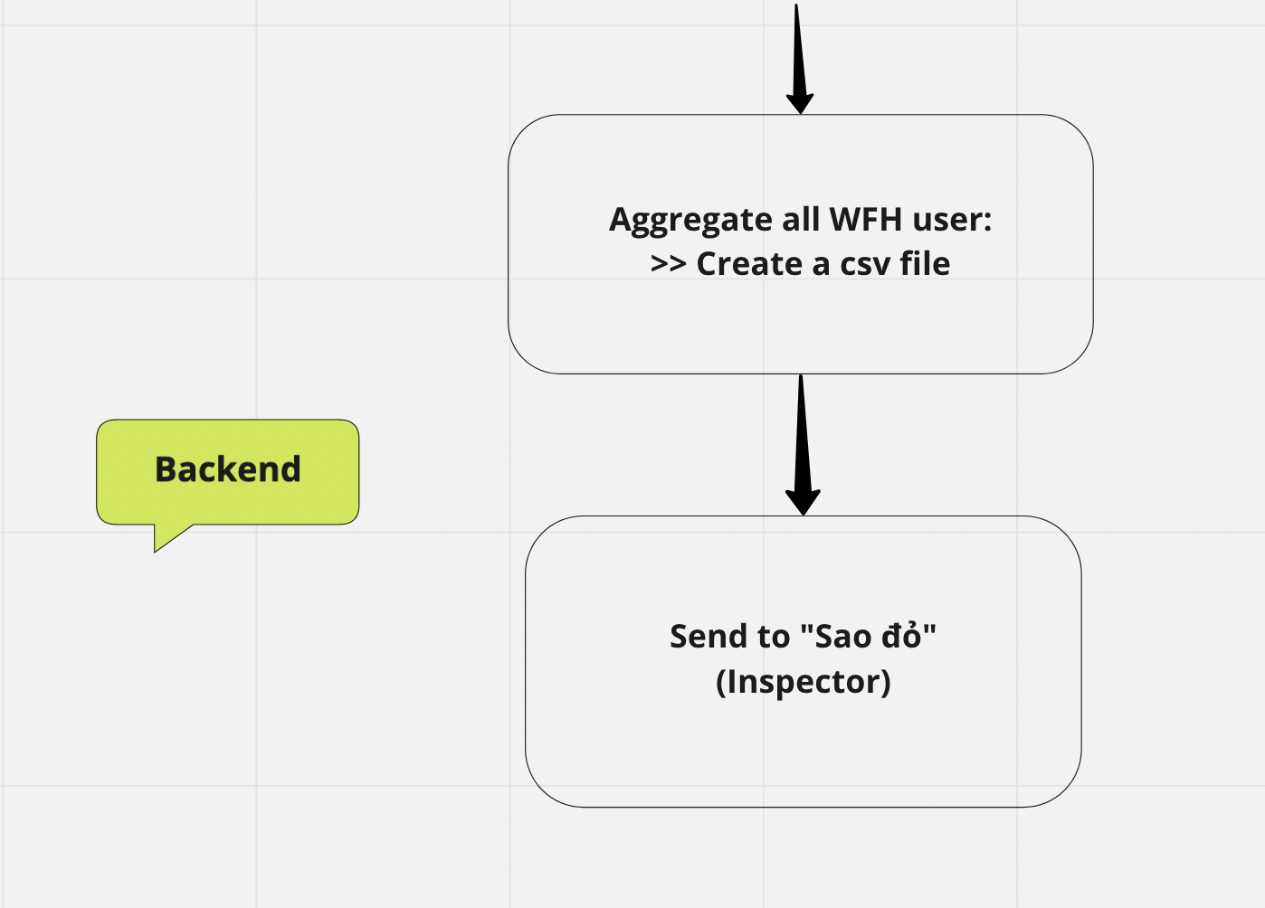
Solution

Slide 6


Technology

Slide 7




Flow
security code
Giang hồ
Part-time NCC

Slide 8
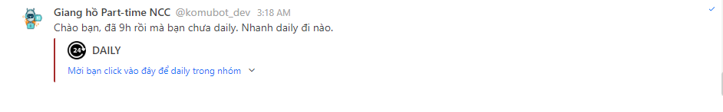
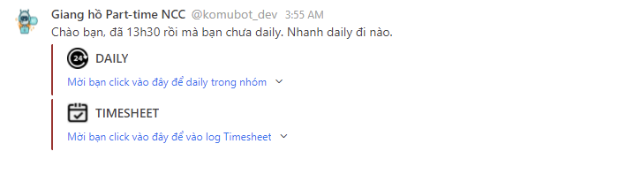
Remind Daily message
Punishment message

Slide 9
Thanks!
Does anyone have any questions?
thao.vuthiphuong@ncc.asia
+84 395230202
ncc.asia

